Slide 1
Analysis of Factors that Influence the Conditions of Bridges in California
01
TEAM 8
Swetha Sathishkumar
Appala Dhanush BaliReddy
Manasa Rajagopal Madabushi
Lavanya Nerale Ramesh
Syama Latha Seera
AIT-614 SECTION 002
BIG DATA ESSENTIALS
INSTRUCTOR: DR. EDDY ZHANG
GEORGE MASON UNIVERSITY
20 NOVEMBER 2024

Slide 2

Introduction
02
Context
Bridges are essential for infrastructure safety and mobility.
There are a lot of old bridges in California that need to be carefully analyzed in order to determine their maintenance priorities.
Scope:
Analyze data and draw insights specific to some of the top cities in California
Concentrate on determining the primary elements influencing bridge conditions and bridge length in the state of California.

Slide 3
Project Objectives
03
1
2
3
Identify some key trends and patterns about the all the bridges in California
Identify factors that influence influence bridge length and bridge conditions
Predict bridge conditions using machine learning models.

Slide 4
Project Timeline
04
Task | Timeline
Setup Databricks Environment | 10/27
Data Cleaning | 11/02
Work on the first draft of the final report | 11/07
Data analysis using PySpark | 11/12
Work on Project Presentation/Final Paper | 11/15
Implementation of ML | 11/17
Testing + Team Evaluation | 11/19
Complete Final Report/Project Presentation | 11/19
All the project deliverables are due | 11/19

Slide 5

Dataset : infoBridge Portal by the Federal Highway Administration.
05
Title : InfoBridge Portal by the Federal Highway Administration.
Limited to just bridges in California
Dataset Characteristics :
Data points : 25000
Data Features : 20
Columns used for analysis include County Main, Main Span Material, Bridge Age, etc.
Source: https://infobridge.fhwa.dot.gov/Data/SelectedBridges

Slide 6
The System
06
Collect Data From InfoBridge Portal
Big Data Platform Used; Azure Databricks: For big data processing and analytics.ntegrated environment for data cleaning, exploration, and machine learning.
PySpark: For distributed data processing and handling large datasets. Enabled efficient data cleaning, transformation, and feature engineering.
Spark Mllib: Used for implementing clustering and regression. Optimized for scalability and performance.
NoSQL Database (Databricks DBFS): Provided storage for the bridge dataset.
Techniques:
Data Cleaning & Processing
Exploratory Data Analysis
Machine Learning Models
Visualizations
Store Data in Databricks DBFS
Process Data Using PySpark
Create Machine Learning Models
Draw Conclusions

Slide 7
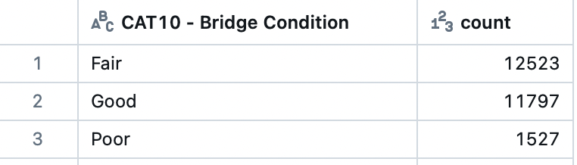
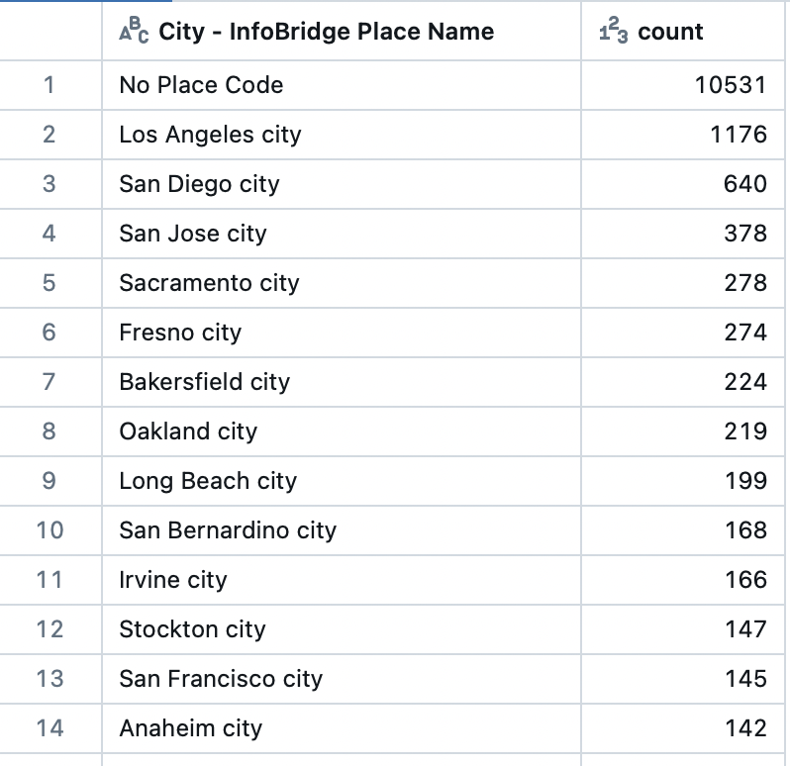
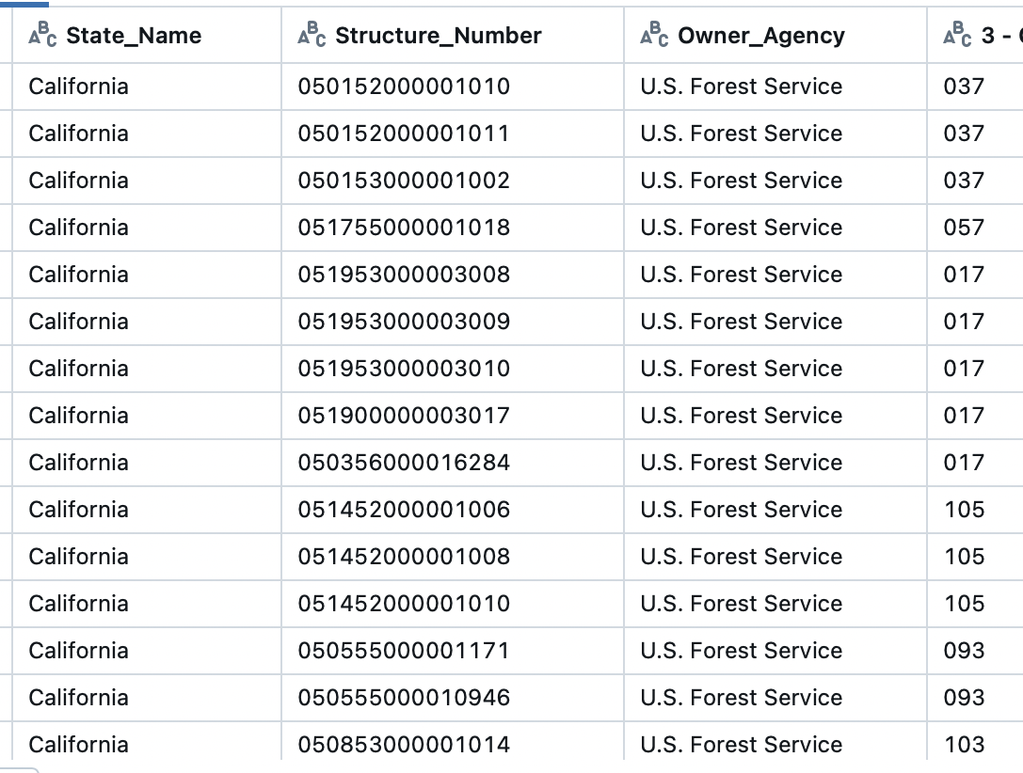
Results and Analysis
07
Used PySpark to pre-process, clean, group and summarize the data
Some of the summaries are listed on the slide

Slide 8
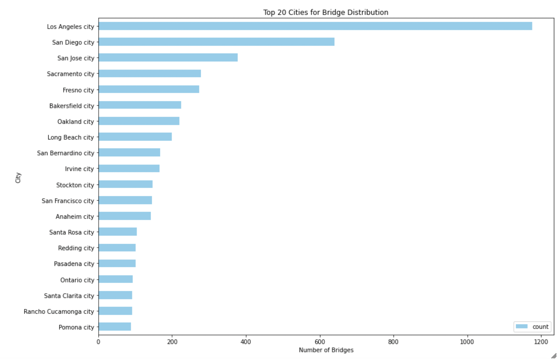
Results and Analysis
08
We identified the top 20 cities with the most number of bridges
We dropped “No Place Code”
Los Angeles, San Diego and San Jose are the top 3 cities

Slide 9
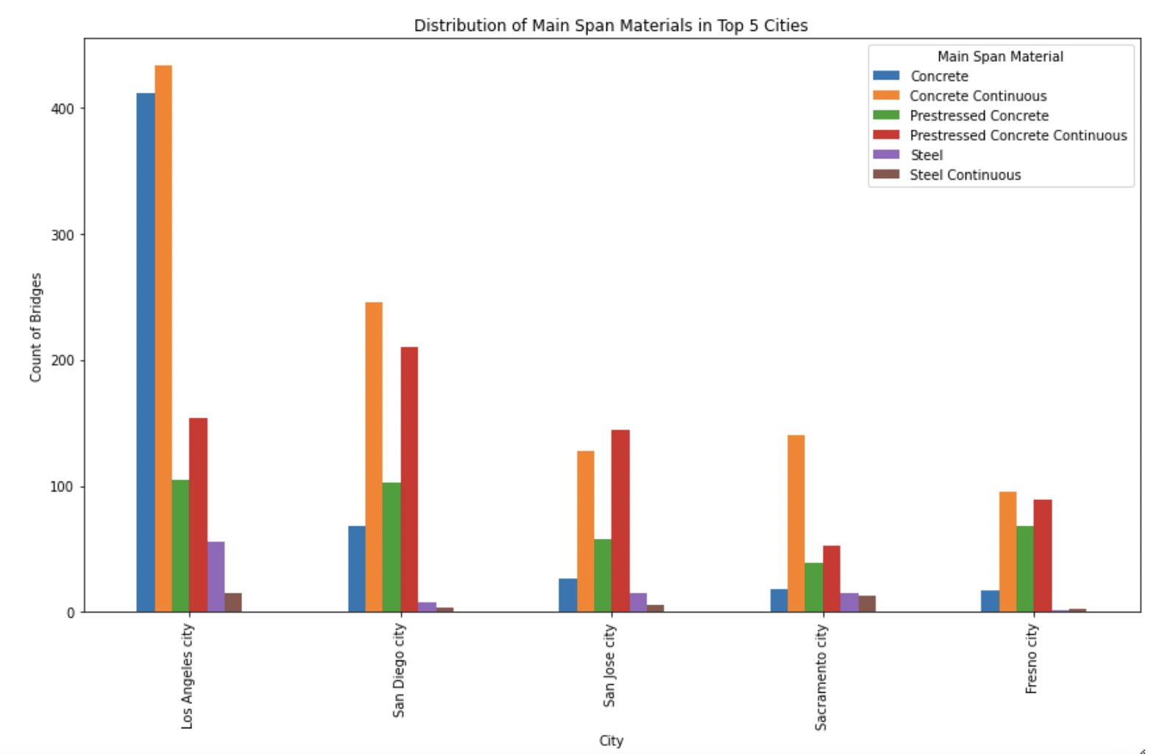
Results and Analysis
09
We identified the main span materials used in Top 5 cities in California with the most bridges
Concrete Continuous/Prestressed are the two most commonly used materials for bridges
Except for Los Angeles!!
Notes:
Concrete is the most commonly used in Californian bridges - it makes sense because concrete offers protection against earthquakes. It is also helps when using concrete with long span bridges and it is also easy to maintain in California’s dry climate
Concrete continus have a high tensile strength and is commonly used in most of the bridges in California’s top 5 cities
Second most used is pre-stressed concrete continuous which has a much higher tensile strength
Except for LA, the second most spanning material is Plain Concrete which has a low tensile strength. This could be because LA experienced rapid
growth in the 20th century, and concrete technology was not evolved back then

Slide 10
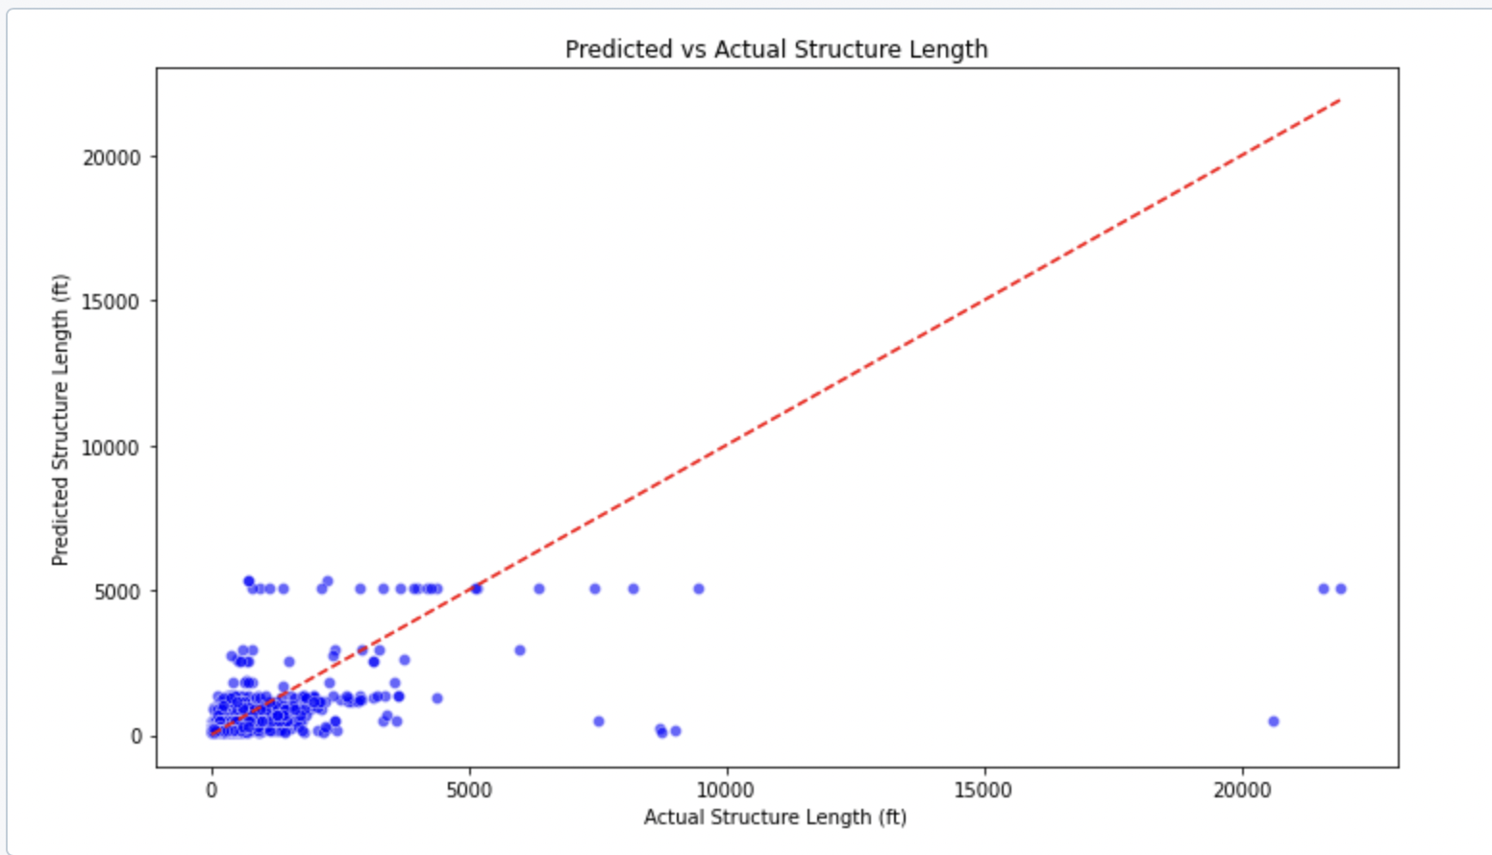
Predicting Structure Length Based on Number of Spans
10
The model is trained to predict the structure length of a bridge based on the number of spans in its main unit using a Random Forest Regressor.
Number of Spans does not have a strong correlation with Structure Length
Notes:
In this code, the model is trained to predict the **structure length** of a bridge based on the **number of spans** in its main unit using a **Random Forest Regressor**. The dataset is first cleaned by filling missing values with the median of the respective columns and transforming the relevant features into a format suitable for modeling. The data is split into training and test sets, and the model is trained on the training data before making predictions on the test data, which are then displayed alongside the actual values.

Slide 11
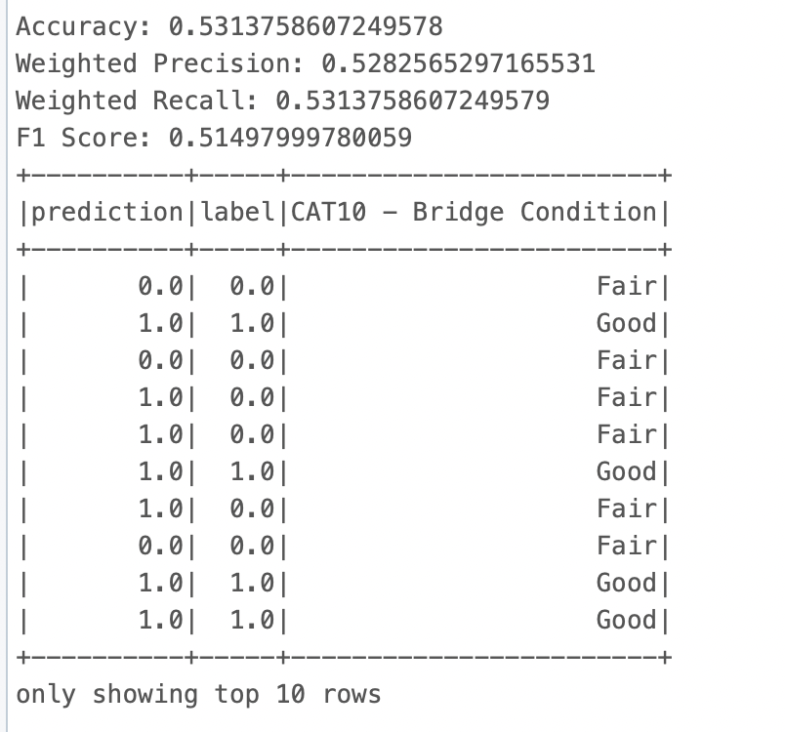
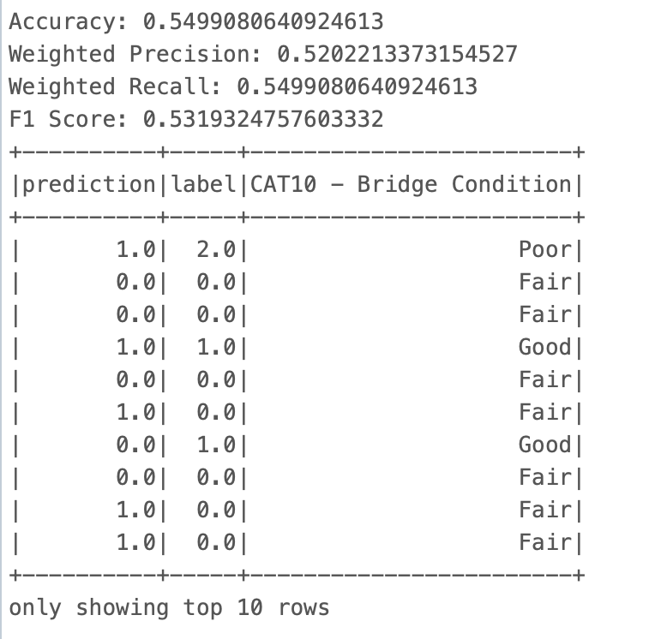
Prediction Bridge Conditions
11
Original Features: Main Span Material, Main Span Design & Number of Spans)
Performance is moderate. not highly effective
Refined Features: Main Span Material and Bridge Age)
Performance is moderate. not highly effective

Slide 12
Conclusion
12
This research successfully used machine learning and big data analytics to examine the variables affecting the lifespan and upkeep requirements of California bridges.
Regression and clustering models were used to provide useful information on bridge deterioration, which helped transportation authorities set maintenance priorities.
This study demonstrates how predictive analytics may be used in infrastructure design to improve public safety and allocate resources optimally for long-term bridge reliability in a scalable and data-driven manner.
We learned to clean and analyze a sizable dataset using technologies like Databricks, PySpark, and Spark MLlib, revealing important trends and patterns pertaining to bridge conditions, materials, length, etc.

Slide 13


FUTURE SCOPE
13
TO PROVIDE A MORE THOROUGH ANALYSIS OF BRIDGE PERFORMANCE, FUTURE IMPROVEMENTS TO THIS PROJECT MIGHT INVOLVE ADDING EXTRA DATASETS, SUCH AS ENVIRONMENTAL PARAMETERS AND MAINTENANCE RECORDS.
TO INCREASE PREDICTION ACCURACY AND CAPTURE INTRICATE CORRELATIONS BETWEEN INFORMATION, ADVANCED MACHINE LEARNING TECHNIQUES SUCH AS GRADIENT BOOSTING OR NEURAL NETWORKS COULD BE INVESTIGATED.
MOREOVER, DYNAMIC MONITORING AND PREDICTIVE MAINTENANCE WOULD BE MADE POSSIBLE BY INCORPORATING REAL-TIME DATA STREAMS, SUCH AS REAL-TIME TRAFFIC COUNTS OR SENSOR DATA FROM SMART BRIDGES.
BROADENING THE GEOGRAPHIC FOCUS TO ENCOMPASS BRIDGES IN SEVERAL STATES MAY ALSO OFFER MORE COMPREHENSIVE INSIGHTS ON NATIONAL INFRASTRUCTURE PATTERNS, ASSISTING IN THE DEVELOPMENT OF MORE EFFICIENT POLICIES AND THE DISTRIBUTION OF RESOURCES.

Slide 14
Acknowledgements and References
14
Acknowledgements: Professor Zhang, Parth Dalal, Family & Friends
[1] Yang, C., Lou, P., Nassif, H., & States., U. (2024, May). Correlation of Bridge Deck Deterioration with Truckload Spectra Based on NBI Condition Rating and Weigh-In-Motion Data. Bts.gov; United States. Department of Transportation. Federal Highway Administration. Office of Research, Development, and Technology. https://rosap.ntl.bts.gov/view/dot/74540 Accessed 21 Oct. 2024.
[2] Alipour, A., Shafei, B., Mock, A., Prajapat, K., & State, I. (2020, June). Development of a Life-Cycle Cost Analysis Tool for Improved Maintenance and Management of Bridges. Bts.gov; Iowa State University. Institute for Transportation. https://rosap.ntl.bts.gov/view/dot/55485 Accessed 21 Oct. 2024.
[3] Data - LTBP InfoBridge. (2020). Dot.gov. https://infobridge.fhwa.dot.gov/Data/SelectedBridges Accessed 21 Oct. 2024.

Slide 15

15
THANK YOU FOR YOUR TIME AND ATTENTION!
ANY QUESTIONS?

